Slide 1
CSE 2451 Binary Tree
Zichen Zhang

Slide 2
Overview
Tree & binary tree
Traverse a binary tree
Tree node struct
Breadth first traversal
Depth first traversal
Inorder
Preorder
Postorder
Create tree node
Delete a tree

Slide 3
Tree
Trees are hierarchical data structures; they represents the relationship of the data by the way the associated tree nodes are organized
Each node in the tree carries some data
The relationship of the data stored in different nodes are represented by connections between the nodes
The top node of a tree is called the root of the tree (i.e., node A)
There are parent-child node relationships in a tree represented by the edges connecting the nodes
Node B is the parent node of nodes D, E, F
The nodes with no child are called the leaf nodes
D, E, F, G, I are all leaf nodes
A
root
B
C
D
E
F
G
H
leaves
I

Slide 4
Binary tree
Binary tree refers to a specific type of tree data structure that has at most two children per node
Binary trees are widely used to solve practical problems
Binary search tree
Huffman tree
Depth of a node is the number of edges connecting the node to the root of the tree
Depth(A) = 0
Depth(B) = 1
Depth (H) = 3
Height of a node is the number of edges from the node to its deepest leaf
Height(A) = 3 = height of the tree
Height(B) = 1
Height(H) = 0
A
root
B
C
D
E
F
G
leaves
H

Slide 5
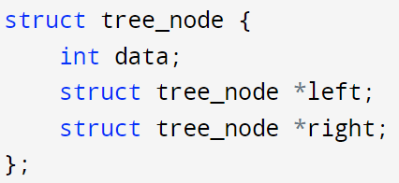
Tree node struct
Use struct as building blocks to construct a binary tree
Since binary tree node will have at most two children, we just need two pointer members, left and right in the struct
A
root
B
C
use data member to store information
Use pointers left and right to point to children nodes
D
E
F
G
leaves
H

Slide 6
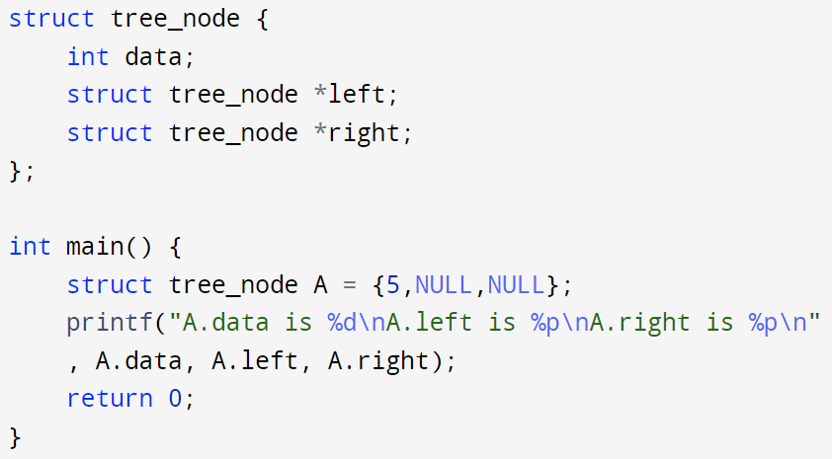
Tree node struct
Use struct as building blocks to construct a binary tree
5
root
use NULL to specify current node doesn’t have left or right child node

Slide 7
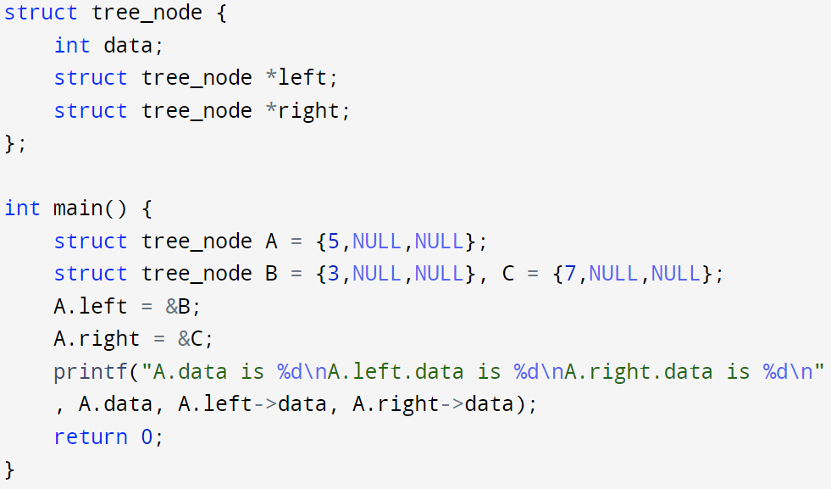
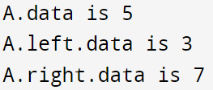
Tree node struct
Use struct as building blocks to construct a binary tree
5
root
3
7
Points left and right pointers of node A to its children nodes B and C to represent the edges

Slide 8
Traverse a binary tree
Unlike linear data structures like array, linked list, etc., binary tree is a hierarchical data structure, there’re many different orders to traverse through a binary tree
Breadth first traversal (level order traversal)
Go through nodes of the tree in a level-by-level fashion, starting from the root node
A->B->C->D->E->F->G->H
Depth first traversal
Inorder (left, root, right): D->B->E->A->F->C->H->G
Preorder (root, left, right): A->B->D->E->C->F->G->H
Postorder (left, right, root): D->E->B->F->H->G->C->A
A
root
B
C
D
E
F
G
leaves
H

Slide 9
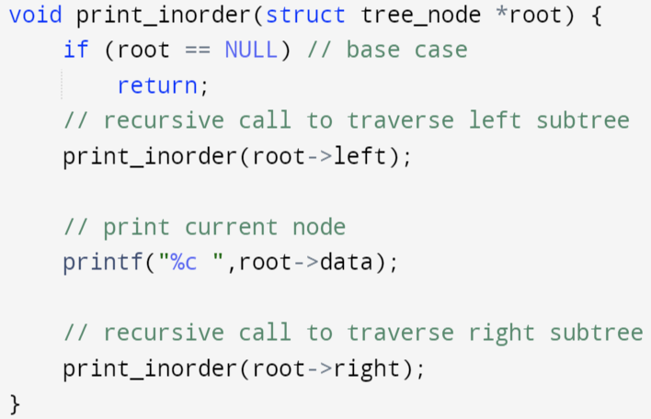
Traverse a binary tree: inorder traversal
Inorder (left, root, right): D->B->E->A->F->C->H->G
Recursively visit each tree node: for each node / subtree, visit its members in the following order:
Left child/subtree
The node itself (root of current subtree)
Right child/subtree
A
root
B
C
D
E
F
G
action
leaves
H
Print current node data
After traversing left subtree

Slide 10
Traverse a binary tree: inorder traversal
Inorder (left, root, right): D->B->E->A->F->C->H->G
Recursively visit each tree node: for each node / subtree, visit its members in the following order:
Left child/subtree
The node itself (root of current subtree)
Right child/subtree
1 print_inorder(&A)
A
root
2
B
C
3
D
E
F
G
action
H
Solid arrow: recursive call to subtree
Dash arrow: return to previous recursive call
Current stdout: D

Slide 11
Traverse a binary tree: inorder traversal
Inorder (left, root, right): D->B->E->A->F->C->H->G
Recursively visit each tree node: for each node / subtree, visit its members in the following order:
Left child/subtree
The node itself (root of current subtree)
Right child/subtree
1 print_inorder(&A)
A
root
2
7
B
C
3
5
4
6
D
E
F
G
action
H
Solid arrow: recursive call to subtree
Dash arrow: return to previous recursive call
Current stdout: D B E A

Slide 12
Traverse a binary tree: inorder traversal
Inorder (left, root, right): D->B->E->A->F->C->H->G
Recursively visit each tree node: for each node / subtree, visit its members in the following order:
Left child/subtree
The node itself (root of current subtree)
Right child/subtree
1 print_inorder(&A)
A
root
2
8
7
B
C
3
5
9
4
6
10
D
E
F
G
action
H
Solid arrow: recursive call to subtree
Dash arrow: return to previous recursive call
Current stdout: D B E A F C

Slide 13
Traverse a binary tree: inorder traversal
Inorder (left, root, right): D->B->E->A->F->C->H->G
Recursively visit each tree node: for each node / subtree, visit its members in the following order:
Left child/subtree
The node itself (root of current subtree)
Right child/subtree
1 print_inorder(&A)
A
root
2
8
7
B
C
3
5
9
11
4
6
10
D
E
F
G
12
action
H
13
Solid arrow: recursive call to subtree
Dash arrow: return to previous recursive call
Current stdout: D B E A F C H G,
we’ve printed out all node data

Slide 14
Traverse a binary tree: inorder traversal
Inorder (left, root, right): D->B->E->A->F->C->H->G
Recursively visit each tree node: for each node / subtree, visit its members in the following order:
Left child/subtree
The node itself (root of current subtree)
Right child/subtree
1 print_inorder(&A)
A
root
2
8
7
15
B
C
3
5
9
11
4
6
10
14
D
E
F
G
12
action
H
13
Solid arrow: recursive call to subtree
Dash arrow: return to previous recursive call
Current stdout: D B E A F C H G,
function print_inorder(&A) finished!
Notes:
25 minutes

Slide 15

Traverse a binary tree: inorder traversal
Inorder (left, root, right): D->B->E->A->F->C->H->G
Recursively visit each tree node: for each node / subtree, visit its members in the following order:
Left child/subtree
The node itself (root of current subtree)
Right child/subtree
1 print_inorder(&A)
A
root
2
8
7
15
B
C
3
5
9
11
4
6
10
14
D
E
F
G
12
action
H
13

Slide 16
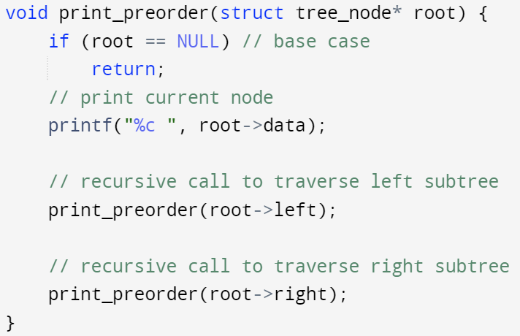

Traverse a binary tree: preorder traversal
preorder (root, left, right): A->B->D->E->C->F->G->H
Recursively visit each tree node: for each node / subtree, visit its members in the following order:
The node itself (root of current subtree)
Left child/subtree
Right child/subtree
1 print_preorder(&A)
A
root
2
8
7
15
B
C
3
5
9
11
action
4
6
10
14
D
E
F
G
12
H
13
Print current node data
before traversing left subtree

Slide 17
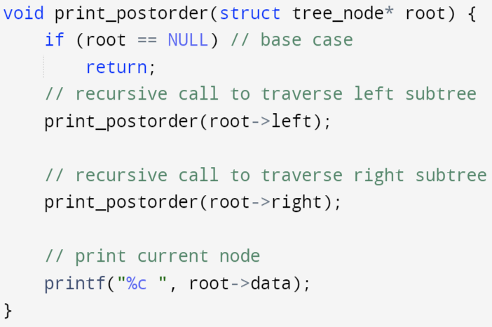

Traverse a binary tree: postorder traversal
postorder (left, right, root): D->E->B->F->H->G->C->A
Recursively visit each tree node: for each node / subtree, visit its members in the following order:
Left child/subtree
Right child/subtree
The node itself (root of current subtree)
1 print_postorder(&A)
A
root
2
8
7
15
B
C
3
5
9
11
4
6
10
14
D
E
F
G
12
H
13
Print current node data
after traversing right subtree
action

Slide 18
Traverse a binary tree
For inorder, preorder, and postorder traversal, the recursive function calls visit the tree nodes in the same order.
But the actions to print the associated node value are in different orders!
Inorder (left, root, right)
Preorder (root, left, right)
Postorder (left, right, root)
action
action
action

Slide 19
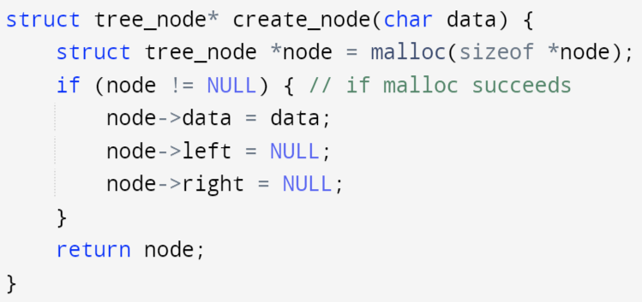
Create tree node (similar as in Linked List)
Use dynamic memory allocation to create tree node
In a more realistic settings, you need to check if malloc is successfully or not
A
root
B
C
D
E
F
G
leaves
H

Slide 20
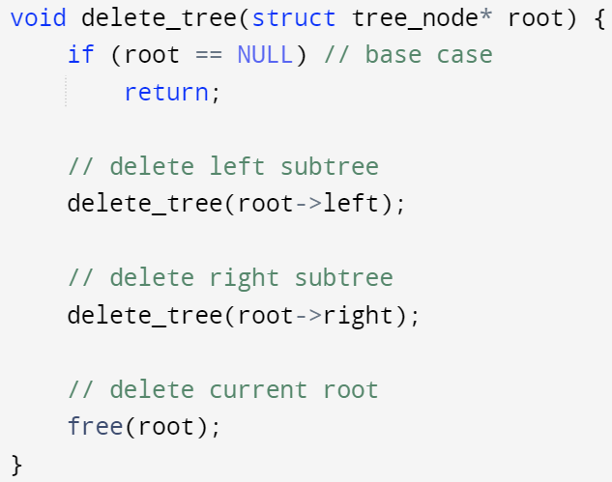
Delete a tree: use postorder traversal
To delete a tree, we need to free the associated tree nodes in a bottom-up order
Free the children before free the current node
Otherwise, you would lose the address of the children
Postorder traversal (left, right, root)
For each subtree, delete its left subtree first, then delete its right subtree, and eventually delete its root
Order of free() on tree nodes: D->E->B->F->H->G->C->A
A
root
B
C
D
E
F
G
leaves
H
Change action from print node data to free the node
Free nodes in postorder: D->E->B->F->H->G->C->A
It easy to verify that if we free tree nodes in postorder, we won’t free any tree node before freeing its children. Therefore, we won’t miss any tree node

Slide 21
Summary
Inorder (left, root, right) traversal
D->B->E->A->F->C->H->G
Returns root in the middle, which partitions the nodes of left and right subtrees
Preorder (root, left, right) traversal
A->B->D->E->C->F->G->H
Returns root as the first node
Postorder (left, right, root) traversal
D->E->B->F->H->G->C->A
Returns root in the end
The order of the recursive function calls on the tree node is different than the associated traversing or visiting order (in,pre,post orders), the later depends on when the actions are taken place for the current node, e.g.,:
Print current node’s data
Delete/free current node
A
root
B
C
D
E
F
G
leaves
H

